Slide 2
Introduction
The difference between book value of current asset and current liabilities
Meaning and concept
Types
Needs
Determinants
Computation
Sources

Slide 3
Meaning: Fixed versus working capital
Working Capital is needed for meeting day to day requirement of the business concern
Concept:
Gross WC: capital invested in total current asset
Net WC: NWC= CA-CL

Slide 4
Working-capital management includes a number of key elements related to company finances, i.e., short-term receivables, inventories, cash, and short-term liabilities.
Apart from current assets and current liabilities, profits that generate sales revenue are the third most important element that significantly influences the level of net working capital.

Slide 5
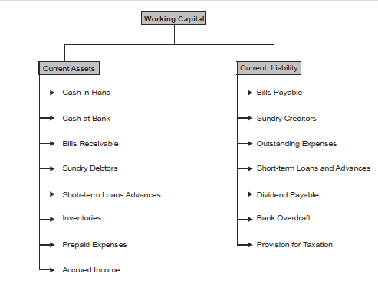
Components

Slide 6
Management of working Capital
Inventories → management and working capital management
Necessary to introduce various methods
Receivable from customers → managing liabilities towards suppliers

Slide 7
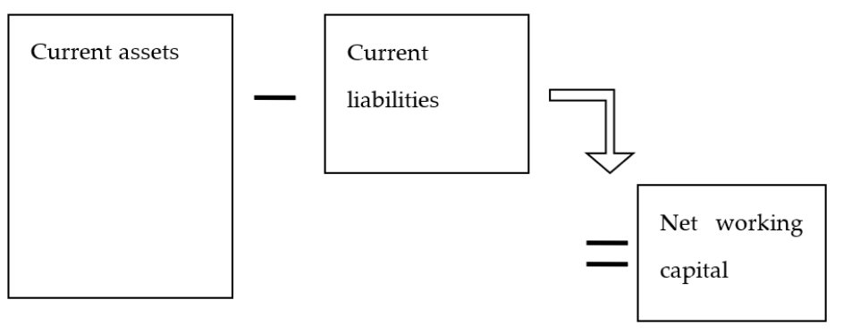
Levels of working capital

Slide 8
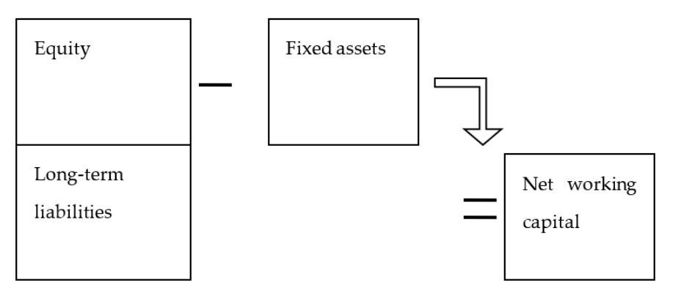
Levels of working capital

Slide 9
Types of WC
Permanent WC: It is the capital that the business concern must maintain certain amount of capital at minimum level at all times.
Temporary WC: It is the amount of capital which is required to meet the seasonal demands and some special purposes.
Semi-Variable WC: Certain amount of Working Capital is in the field level up to a certain stage and after that it will increase depending upon the change of sales or time.

Slide 10
Needs of WC
Purchase of raw materials and spares:
Payment of wages and salary
Day-to-day expenses:
Provide credit obligations:

Slide 11
Working capital position
Causes and effects of excessive working capital
Leads to unnecessary accumulation of raw materials, components and spares
Creates bad debts, and increases collection period
Profit reduces
Causes and effects of inadequate working capital
Cannot buy its requirements in bulk order
It become difficult to implement its operating plans
It become impossible to utilize efficiently the fixed asset
Leads to decline in rate of return in investment

Slide 12
Factors determining working capital requirements-1
Nature of business: If the business concerns follow rigid credit policy and sell goods only for cash, they can maintain lesser amount of Working Capital . Transport and construction company
Production cycle : If the production cycle length is small, they need to maintain lesser amount of Working Capital
Business cycle: In the booming conditions, the Working Capital requirement is larger and in the depression condition, requirement of Working Capital will reduce
Production policy : If the company maintains the continues production policy, there is a need of regular Working Capital

Slide 13
Factors determining working capital requirements-2
Credit policy: If the company maintains liberal credit policy to collect the payments from its customers, they have to maintain more Working Capital
Growth and expansion: During the growth and expansion of the business concern, Working Capital requirements are higher
Earning capacity: If the business concern consists of high level of earning capacity, they can generate more Working Capital, with the help of cash from operation

Slide 14
Computation of working capital
Operating cycle method:
begins with the acquisition of raw material and ends with the collection of receivables.
Raw material
Work in process
Finished good
Debtors collection
Creditors payment

Slide 15
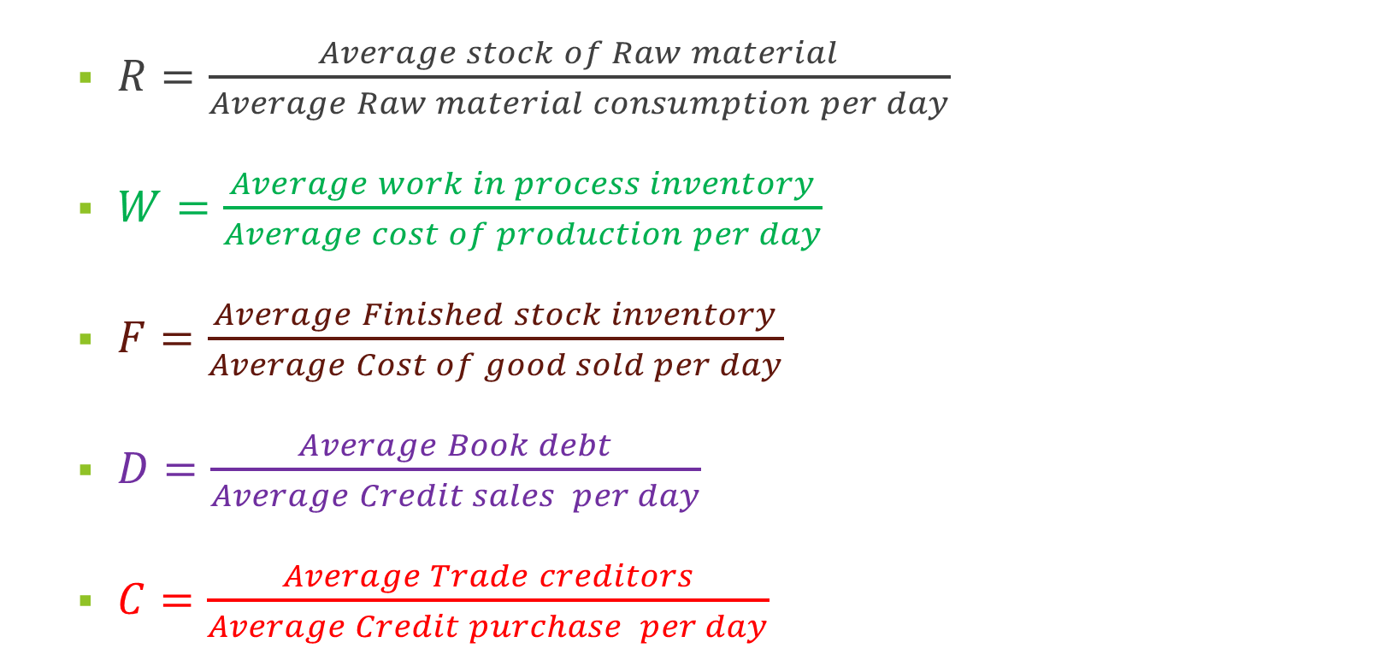
Component calculation
$R=\frac{Average stock of Raw material}{Average Raw material consumption per day}$
$W=\frac{Average work in process inventory}{Average cost of production per day}$
$F=\frac{Average Finished stock inventory}{Average Cost of good sold per day}$
$D=\frac{Average Book debt}{Average Credit sales per day}$
$C=\frac{Average Trade creditors}{Average Credit purchase per day}$

Slide 16
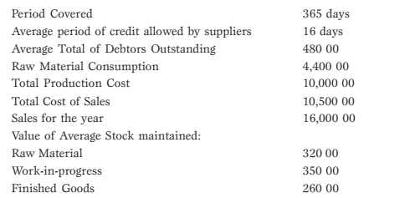
Example: From the following information extracted from the books of a manufacturing company, compute the operating cycle in days and the amount of working capital required:

Slide 17
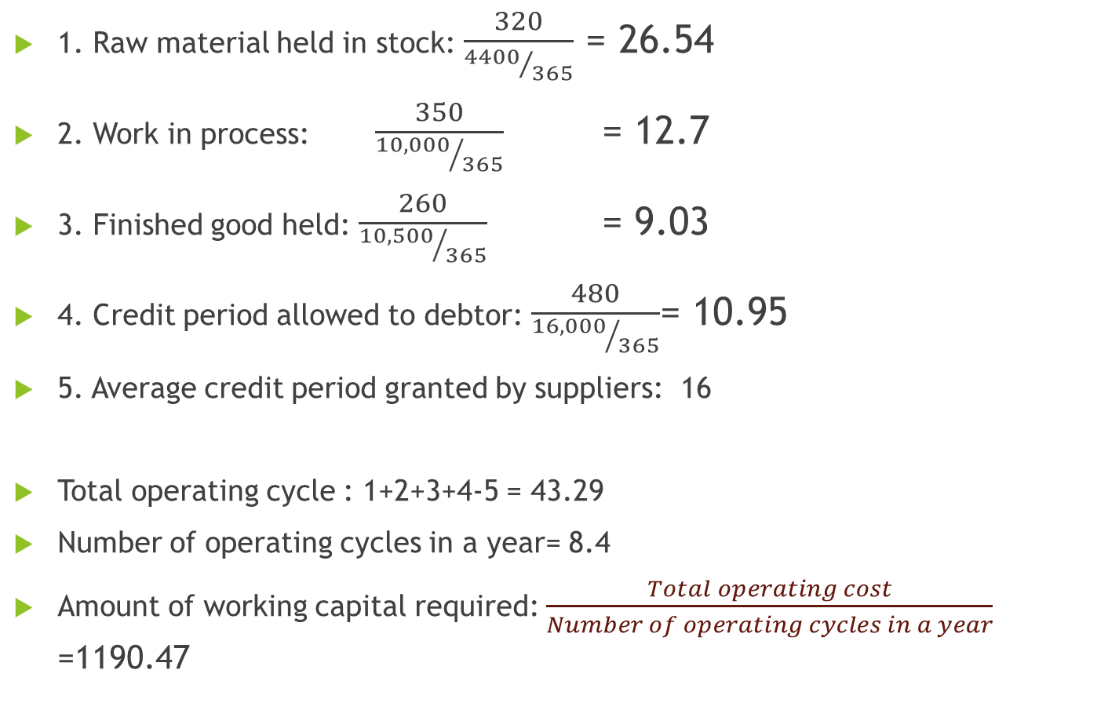
1. Raw material held in stock: $\frac{320}{{4400}/{365}}$ = 26.54
2. Work in process: $\frac{350}{{10,000}/{365}}$ = 12.7
3. Finished good held: $\frac{260}{{10,500}/{365}}$ = 9.03
4. Credit period allowed to debtor: $\frac{480}{{16,000}/{365}}$= 10.95
5. Average credit period granted by suppliers: 16
Total operating cycle : 1+2+3+4-5 = 43.29
Number of operating cycles in a year= 8.4
Amount of working capital required: $\frac{Total operating cost}{Number of operating cycles in a year}$ =1190.47

Slide 18
The length of this cycle consists of the inventory-, the receivables, and liabilities-conversion cycles.
Working-capital management involves both choosing the amount to invest and managing the cash-conversion cycle
Working-capital turnover is related to the operating cycle (OC) and the cash-conversion cycle (CCC)
Cash Conversion Cycle

Slide 19
Working capital management
The experience of 2008 crisis → the collapse of financial market --→ decline in real estate value --→ a situation of wealth having on paper --→ lacking liquid asset
Proper financial planning- the analyzation of existing state of financial affairs and a realistic estimation of the future
It can be a short-term or long-term

Slide 20
Cash Conversion cycle
Two components:
(i) planning for cash flows, and (ii) planning for profit
A good cash budget becomes a foundation for a profit plan
Profit plan is also known as pro forma statement
We will look at the cash and its management

Slide 21
Cash budget
Cash inflows (+) and cash outflows (-)
Net working capital is related to cash, but not specifically cash
Difference between what we currently owe and what we currently own ( immediate sources and uses of cash)
Working capital management is the day to day management of cash, inventories, receivables, and payables

Slide 22
Seasonal requirements
Demand for working capital is not constant
A company has $25,000 in cash, $100,000 in inventory and $80,000 in Accounts Receivable (A/R). Their Accounts Payable (A/P) is stable at $55,000. What is their permanent funding requirement?
= $ 25,000+ 100,000+80,000-55,000 = $150,000
The company has the same current asset requirements for part of the year. The other part of the year their inventory peaks at $140,000 and their A/R peaks at $135,000. What is their seasonal funding needs?
$ 25,000+ 140,000+135,000-55,000= $245,000
So, during the peak season they need to have an extra $95,000 funding.

Slide 23
Meaning of Cash Conversion Cycle
Length of time between purchase of raw-materials and collection of cash from debtors
Indicates the efficiency of managing working capital, and can be comparable
Constructed by deducting the payable deferral period from the addition of inventory conversion period and receivable collection period.
Operating Cycle versus CCC
An operating cycle represents the amount of time it takes a company to acquire inventory, sell that inventory, and receive cash from its customers in exchange for the inventory sold.
Cash cycle represents the amount of time it takes a company to convert resources into cash
While both cycles serve similar purposes, the operating cycle offers insight into a company's operating efficiencies, while the cash cycle offers insight as to how well a company is managing its cash flow.

Slide 24
The difference
Cash conversion cycle
Days of inventory outstanding + days of sales outstanding Days payable outstanding
Operating cycle

Slide 25
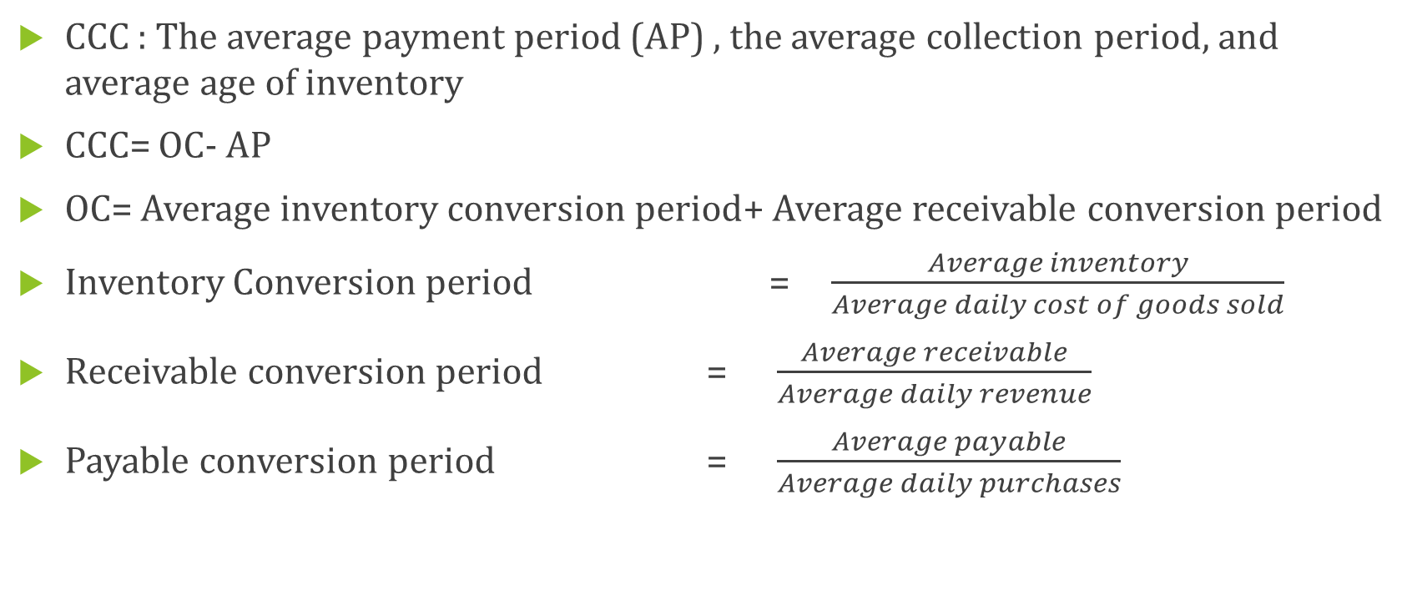
Computing CCC
CCC : The average payment period (AP) , the average collection period, and average age of inventory
CCC= OC- AP
OC= Average inventory conversion period+ Average receivable conversion period
Inventory Conversion period = $\frac{Average inventory}{Average daily cost of goods sold}$
Receivable conversion period = $\frac{Average receivable}{Average daily revenue}$
Payable conversion period = $\frac{Average payable}{Average daily purchases}$

Slide 26
Calculate CCC from the following information
We have: 60,000 (inventory) and sells 3000 worth of goods every day
We have: 120,000 ( receivables) and sells 4000 in revenue
We have to : 30,000 ( payables) and purchases 2000 in raw materials

Slide 27
Answer:
Inventory conversion period: 60,000/3,000= 20 days to sell
Receivable conversion period: 120,000/4,000= 30 days to collect
Payable conversion period: 30,000/2,000= 15 days
= 20+30-15= 35 days

